Slide 1

Information Hiding: The New Digital Age
Dr. Jennifer Davidson
Electrical & Computer Engineering
Department of Mathematics
Information Assurance Colloquium

Slide 2
Overview
Definitions, examples
Digital information hiding & extraction model
Difference between steganography & watermarking
Important issues of trade-off characteristics
Focus on steganography – images
Steganography techniques, examples
Steganalysis
Watermarking
Open problems
Software demonstration

Slide 3
Hiding Information
Steganography
  “covered writing” – Greek
  Secret communications that conceal the very existence of the message
Cryptography
  Encode message using encryption or coding techniques
  Know a message is there but cannot understand it

Slide 4
Hiding Information
Watermarking
  Hide information that is directly related to the item in which it is embedded
Historical examples
  Shaved head of messenger
  Invisible ink
  Microdots
  Null ciphers, shift ciphers
  Genomic steganography - stegoDNA
Notes:
Microdots: photographs the size of a printed period having the clarity of type written page
Null cipher: take the 2nd letter of each word in a passage
Shift cipher: shift the alphabet X places to the right
StegoDNA: take different combinations of nucleotides (GCAT) to represent different letters. Create text using this a a code.. Then create DNA strands with these nucleotides, make a microdot by soaking onto paper, affix microdot to paper and send. When received, soak DNA off paper, and read DNA strands to get message.

Slide 5
Digital Information Hiding Model
Main idea: to use redundancy of data (visible, audio) to insert “extra” information
Encryption key,
Other keys
Cover media
Embedding algorithm
Marked media
(Images.
Audio files,
Network packets,
Circuitry/software,
Text)
(Stegomedia)
Information to hide

Slide 6
Digital Information Extraction Model
Must know key information and extraction algorithm to extract hidden message
Encryption key,
Other keys
Stego media
Extraction algorithm
Extracted message

Slide 7
Steganography
Intent: transmit secret message hidden in innocuous-looking cover medium so that its existence is undetectable
Robustness not typically an issue
Capacity desired for message is large
Always invisible
Typically dependent on file format

Slide 8
Places to Hide Information:
Steganography
Images
Audio files
Text
Disk space
Hidden partition
Network Packets
Software
Circuitry

Slide 9
Watermarking
Intent: data embedding conveys some information about the cover medium such as owner, copyright, or other information
Watermark can be considered to be an extended attribute of the data
Robustness of watermark is a main issue
Know watermark may be there
Can be visible or invisible

Slide 10
Issues in Information Hiding
Perceptibility: does embedding information “distort” cover medium to a visually unacceptable level (subjective)
Capacity: how much information can be hidden relative to its perceptibility (information theory)
Robustness to attacks: can embedded data survive manipulation of the stego medium in an effort to destroy, remove, or change the embedded data
Trade-offs between the three:
  More robust => lower capacity
  Lower perceptibility => lower capacity etc.

Slide 11
Types of Steganographic Techniques
Substitution methods
  Bit plane methods
  Palette-based methods
Signal Processing methods
  Transform methods
  Spread spectrum techniques
Coding methods
  Quantizing, dithering
  Error correcting codes
Statistical methods – use hypothesis testing
Cover generation methods - fractals

Slide 12
Steganography: Bit plane Methods
Image: replace least significant bit (LSB) of image intensity with message bit
Replace lowest 3 or 4 LSB with message bits or image data (assume 8 bit values)
Data is hidden in “noise” of image
Can hide surprisingly large amounts of data this way
Very fragile to any image manipulation

Slide 13
Steganography: Bit plane Methods
.
.
.
.
0
1
0
0
1
1
1
0
1
1
0

Slide 14
Bit plane Methods
Variations include:
  Using a permutation of pixel locations at which to hide the bits, either pseudo randomly generated or using a prime generator for the additive group Z_{MN} where MN is the size of the image (number of pixels)
  Put bits at only certain locations in image where there is “significant” variation and change in gray-value would not be visually perceptible

Slide 15
Palette-based Methods
Palette manipulation means changing the way the color or grayscale palette represents the image colors
Bit methods are used in palette manipulation schemes
Data hidden in “noise” of image
Often radical color shifts occur - can tip off that data is hidden
Use grayscale to overcome color shift problem

Slide 16
Palette-based Methods
Pseudo color 8-bit image: 256 different colors that are indexed by the numbers 0,…,255
To insert information, for example, S-Tools reduces the number of colors from 256 to 32 and uses the lower LSB bit places to hide data
In this case, 8 colors are the same before data embedding; after data embedding 8 colors are very close visually but differ in their bit representation

Slide 17
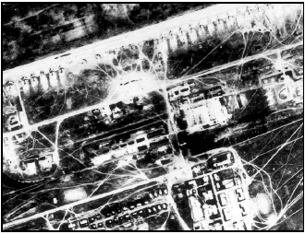
Example: Hide an Image
Example is courtesy of Neil Johnson and S. Jajodia’s paper, Exploring Steganography: Seeing the Unseen, Computer, pp. 26-34, 1998.
Soviet strategic bomber base gathered by EROS (satellite data)

Slide 18
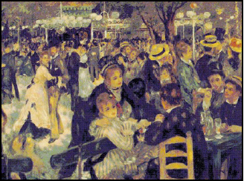
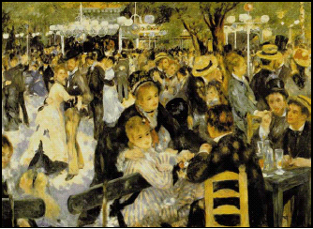
White Noise Storm inserts data by using spread spectrum technology and frequency hopping, but severely changes the palette.
Airfield embedded using White Noise Storm
Original 24-bit Renoir converted to 248 color GIF; Airfield inserted using S-Tools; Final stego image has 256 colors in GIF format.
Airfield embedded using S-Tools with 8-bit Renoir

Slide 19
Palette Methods
Color c_{i} 10110 0 1 0
Color c_{i+1} 10110 0 1 1
When order palette by luminance there are groups of pixel colors that look identical to the eye; L = 0.299R + 0.587G + 0.114B
Airfield is a 3 bit image put in last 3 bits of Renoir image
Very fragile – destroyed by image manipulation

Slide 20
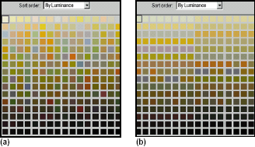
Change of Palette - Renoir
Using S-Tools
(a) Palette of original 8 bit GIF Renoir before inserting Airfield, sorted by luminance
(b) Palette of 8 bit GIF of Renoir stego image after Airfield inserted, sorted by luminance

Slide 21
LSB and Palette Methods
Many different software tools available for LSB data embedding
All suffer from almost total lack of robustness: simply change LSB values and message will be overwritten
Palette methods have patterns that can be analyzed

Slide 22
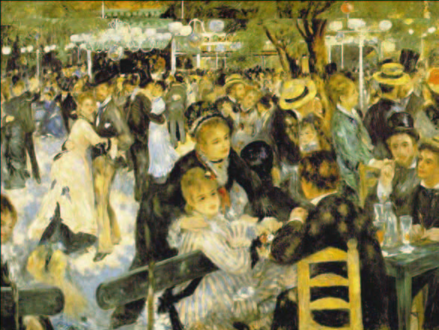
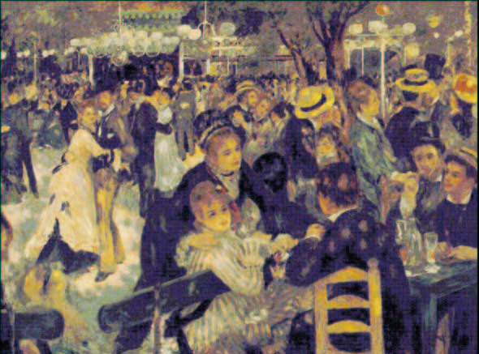
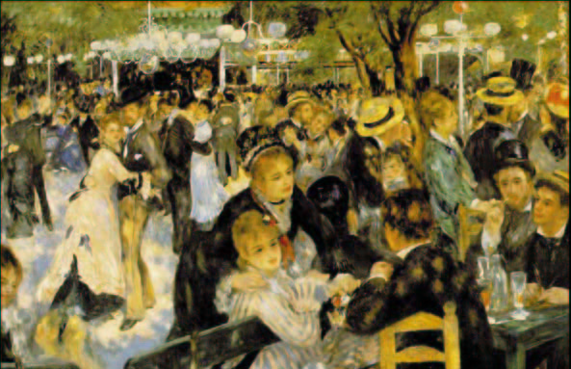
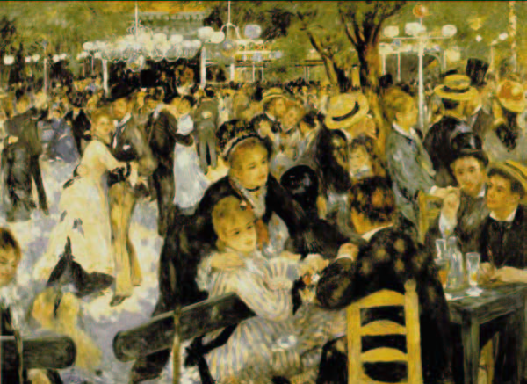
Example: Insertion of a Paragraph of Text
Original Image
Text Hidden using StegoDos
Text Hidden using White Noise Storm
Text Hidden using S-Tools

Slide 23
Steganography: Quantization
Quantization error in a predictive coding scheme can be used to hid information
The difference signal Δ_{i} which equals quantization of the difference between adjacent pixels x_{i} and x_{i+1} transmits the additional information
Predictive coding: Δ_{i} =Q(x_{i+1} - x_{i} )
Error is introduced when quantizing

Slide 24
Quantization
At receiving end, difference signal is dequantized and added to last sample value to create an estimate for x_{i}
The stego-key in this steganographic algorithm is a table that assigns a specific bit to every possible value of Δ_{i}
Example:
  Δ_{i}
_{Bit assignment}
-4
-3
-2
-1
0
1
2
3
4
0
1
0
1
1
1
0
0
1

Slide 25
Quantization
To store the i-th message bit in the cover-image, the quantized difference signal Δ_{i} is computed
If the assigned bit for Δ_{i} does not match the secret bit, then Δ_{i} is replaced with the nearest Δ_{k} whose assigned bit matches the value of the secret bit
The stream of Δ_{i} is then entropy-encoded and sent
At the receiving end the values for Δ_{i} are decoded, and then the stego-key is used to create the list of 0s and 1s depicting the message

Slide 26
Transform Domain Techniques
Discrete Cosine Transform
Discrete Wavelet Transform
Discrete Fourier Transform
Mellin-Fourier Transform
Related:
  Singular Value Decomposition
  Minimax Eigenvalue Decomposition

Slide 27
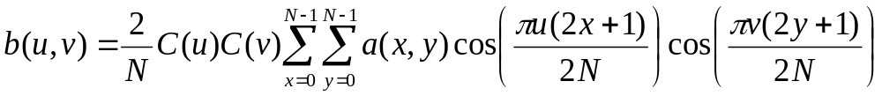
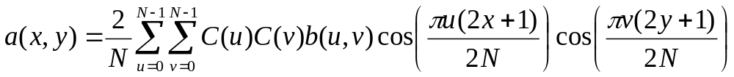
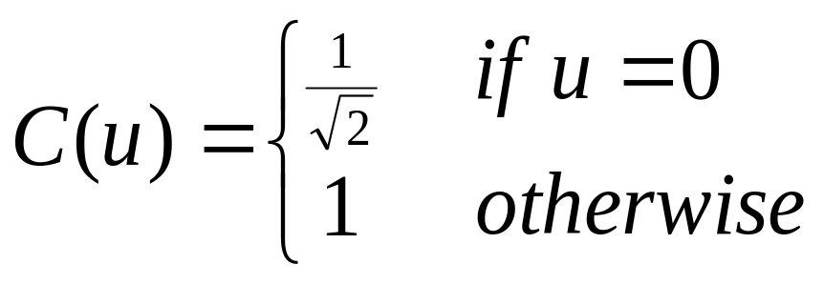
Discrete Cosine Transform
The forward equation, for image A, is
The inverse equation, for image B, is
Here

Slide 28
Discrete Cosine Transform
JPEG uses DCT to compress an image
Many different approaches to use DCT to hide information
Message is embedded in signal, not noise
Studies on visual distortions conducted by source coding community can be used to predict the visible impact of the hidden data in the cover image
Can be implemented in compressed domain, saving time

Slide 29
Discrete Cosine Transform
Basic idea of JPEG:
Convert image to YIQ color space
Each color plane is partitioned into 8x8 blocks
Apply DCT to each block
Values are quantized by dividing with preset quantization values (in a table)
Values are then rounded to nearest integer

Slide 30
JPEG Compression Interface
COMPRESSED IMAGE
8 X 8 BLOCK
ENTROPY ENCODER
DCT
QUANTIZER
(0,0)
16 | 11 | 10 | 16 | 24 | 40 | 51 | 61
12 | 12 | 14 | 19 | 26 | 58 | 60 | 55
14 | 13 | 16 | 24 | 40 | 57 | 69 | 56
14 | 17 | 22 | 29 | 51 | 87 | 80 | 62
18 | 22 | 37 | 56 | 68 | 109 | 103 | 77
24 | 35 | 55 | 64 | 81 | 104 | 113 | 92
49 | 64 | 78 | 87 | 103 | 121 | 120 | 101
72 | 92 | 95 | 98 | 112 | 100 | 103 | 99
QUANTIZERTABLE

Slide 31
Steganography: One Approach using DCT
The sender and receiver agree ahead of time on location for two DCT coefficients in the 8 x 8 block
Middle frequencies with same quantization value: Location 1 is (4,1) & Location 2 is (3,2)
16 | 11 | 10 | 16 | 24 | 40 | 51 | 61
12 | 12 | 14 | 19 | 26 | 58 | 60 | 55
14 | 13 | 16 | 24 | 40 | 57 | 69 | 56
14 | 17 | 22 | 29 | 51 | 87 | 80 | 62
18 | 22 | 37 | 56 | 68 | 109 | 103 | 77
24 | 35 | 55 | 64 | 81 | 104 | 113 | 92
49 | 64 | 78 | 87 | 103 | 121 | 120 | 101
72 | 92 | 95 | 98 | 112 | 100 | 103 | 99

Slide 32
Steganography: DCT
The DCT is applied to each 8 x 8 block in the image producing a block B^{i}
Each block will encode a single bit, 0 or 1
If the message bit is a 1 then the larger of the two values B^{i}(4,1) and B^{i}(3,2) is put in location (4,1), otherwise if the message bit is a 0, the smaller of the two values is put in location (4,1)
Notes:
Middle frequencies are used because information will be stored in significant parts of the signal
Empirical evidence suggests that DCT coefficients for middle frequencies have similar magnitudes
Quantization values are equal and therefore compressed the same according to JPEG

Slide 33
DCT Steganography
If the difference |B^{i}(4,1) - B^{i}(3,2)| < µ, then the values B^{i}(4,1) and B^{i}(3,2) are adjusted so that |B^{i}(4,1) - B^{i}(3,2)| > µ
This assures that the relative difference will not be lost when the compression is done
This last step can introduce distortion into image
The JPEG compression is performed (if desired) and then the resulting image is inversed transformed
Other modifications to this algorithm have been researched that overcome some of these limitations

Slide 34
DCT Steganography
To extract the data, the DCT is performed on each block, and the coefficient values at locations (4,1) and (3,2) are compared
If B^{i}(4,1) > B^{i}(3,2) then the message bit is a 1, otherwise it is a 0

Slide 35
Wavelet Steganography
Many different schemes proposed
Wang and Kao give a multithreshold wavelet coding scheme where coefficients with high values are used to store information
These coefficients are assumed to keep relative values the same even after multiple image processing operations
If the coefficients change value much, the visual difference is noticeable in the image
Can be used for textured and natural images
Notes:
Image protection via watermarking on perceptually significant wavelet coefficients
Houng-Jyh Wang; Kuo, C.-C.J. Multimedia Signal Processing, 1998 IEEE Second Workshop on , 1998
Page(s): 279 -284

Slide 36
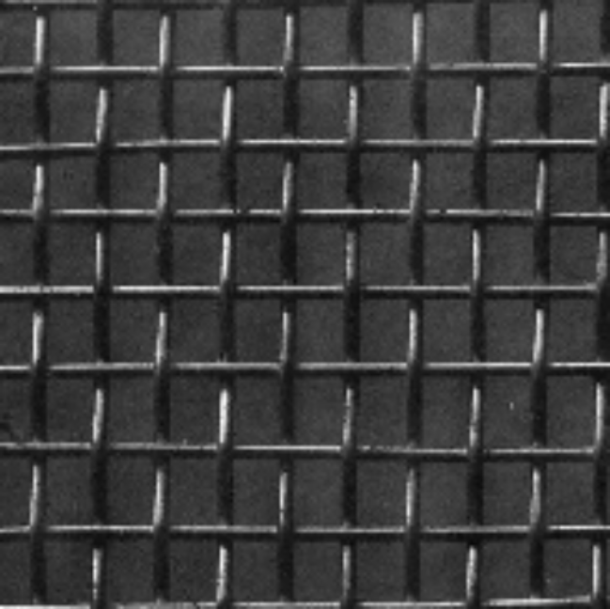
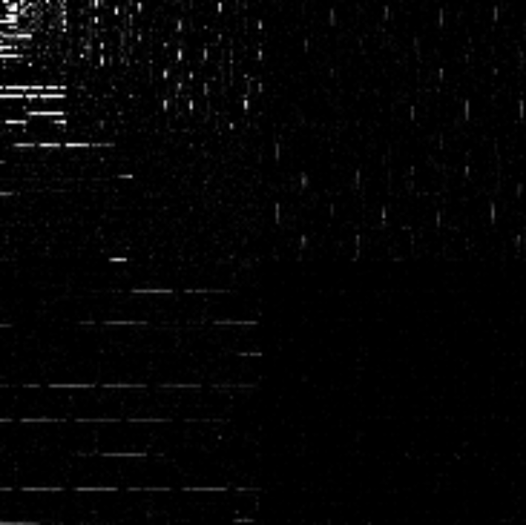
Example of Image and Its Wavelet Transform (no hidden data)
i
i

Slide 37
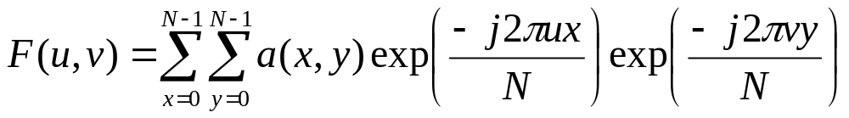
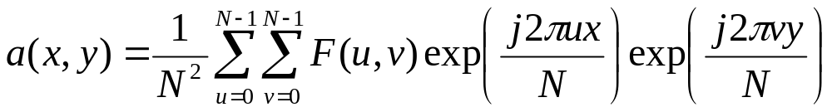
Discrete Fourier Transform
The formulae for the DFT and its inverse are

Slide 38
Discrete Fourier Transform Steganography
The DFT has success when phase modulation is used to hide data
Phase components have less visual impact than magnitude components
Phase components are also more robust against noise distortion
A DFT coefficient is used if its energy is high enough

Slide 39
Mellin-Fourier Transform
Invariant to spatial shifts, scaling, and rotation
Used more in watermarking as robust to these geometric transformations

Slide 40
MELLIN-FOURIER TRANSFORM
ADD WATERMARK HERE
AMPLITUDE ONLY
DFT
DFT⁻¹
LOG-POLAR MAPPING
LPM⁻¹
AMPLITUDE ONLY
DFT
DFT⁻¹
INPUT IMAGE
WATERMARKED IMAGE

Slide 41
Steganalysis :
Analysis of Data Hiding Techniques
Intent:
  Detect only
  Render embedded data useless for extraction
  Remove it altogether
  Change embedded data to look authentic but different from original

Slide 42
Steganalysis
Detection of hidden data from steganographic techniques is a combination of what you know:
  Stego-image only
  Original cover and stegoimage
  Hidden message
  Algorithm used to embed data
  Patterns available from analyzing many stego-images with known cover and their statistical and other characteristics

Slide 43
Steganalysis
Many approaches possible
  Palette
  Histogram characterizations
  Statistical testing
  Header information
Approaches not yet appearing in literature
  Artificial neural networks
  Genetic algorithms
  Simulated annealing
  Other “standard” signal processing techniques

Slide 44
Watermarking Techniques
LSB techniques not typically used – too fragile
Transform techniques – more robust
Add redundancy: place watermarking in several different locations
Not typically dependent on file format
Companies are hungry for practical and complete solutions-but the field is not there yet

Slide 45
Watermarking Systems
Two basic types of systems
Private or nonblind: need original cover data to extract watermark
Public or blind: need only watermarked data
Recall: intent is to create an extended attribute of data
Watermarks are typically more robust

Slide 46
Uses of Watermarking
Copyright protection: to resolve rightful ownership.
  Problems: need very, very high level of robustness; unambiguous watermark
Fingerprinting for traitor tracking: conveys information about recipient rather than source of original data
  Want to trace back illegal copies, similar to serial numbers on software products

Slide 47
Uses of Watermarking
  Problems: need collusion-secure watermarks for multiple copies; high robustness against standard and malicious attacks
Copy protection: to disallow unauthorized copying of the media
  Problem: almost impossible in open systems. In proprietary systems it is easier to indicate the copy status of the data. Example: DVD with “copy never” watermark

Slide 48
Uses of Watermarking
Image authentication: the objective in authentication is to detect modifications of the data
  Use “fragile” watermarks that have a low robustness to say compression
  Other algorithms embed data attributes of the image (found in blocks, such as edge characteristics) and check received image

Slide 49
Typical Attacks and Distortions used on Watermarks
Enhancement: sharpening, contrast, color correction
Additive and multiplicative noise: Gaussian, uniform, speckle
Linear filtering: lowpass, highpass, bandpass
Nonlinear filtering: median filters, rank filters, morphological filters

Slide 50
Typical Attacks and Distortions used to design Watermarks
Lossy compression: JPEG, MPEG2, MPEG4, audio as well
Geometric transformations: shifts, rotations, scaling, shearing (affine)
Data reduction: cropping, clipping, histogram modification
D/A and A/D conversion: print-scan, analog TV transmission

Slide 51
Typical Attacks and Distortions used on Watermarks
Duplicate watermarking
Collusion attacks
Statistical averaging
Mosaic attacks

Slide 52
Security Issues
Watermark security: issues where secrecy of embedded information needs to be assured
Two levels of security:
  Highest level: unauthorized user can neither detect nor extract the watermark
  Lower level: detection of a watermark is permitted by any user, but can’t extract without secret key; i.e. want to copy an image into your Word document

Slide 53
Open Problems
Theoretical foundations are weak
Most systems designed heuristically
Information theory has been used to address issues in capacity, general modeling.
Lots of exciting challenges to be had!

Slide 54
Open Problems
Invertibility problem:
If a watermark is noninvertible, then it is computationally unfeasible for an attacker to find a faked original image and a faked watermark, such that the pair can result in the same watermarked image created by the real owner.

Slide 55
Invertibility Problem
Denote the original image by A. The owner of A uses the watermark (denoted by W ) to make a watermarked image A_{W}. Thus A_{W} = E(A,W), where E is the embedding function.
Suppose that an attacker gets the published A_{W} without knowing A or W, and can create a counterfeit watermark W_{F} and a counterfeit image A_{F} that satisfy
A_{W} = E(A_{F}, W_{F}). (1)
Then the attacker can use A_{F} as her “original” to claim the ownership of A_{W} .
If (1) holds, the watermarking scheme is called invertible.
Otherwise, it is called noninvertible

Slide 56
Conclusions
Many interesting problems and many choices for solutions
Field is very young, not mature
Commercial applications as well (did not touch on in this talk)
Companies interested for digital intellectual property rights
Need more rigorous approach for complete solutions

